Slide 1
Chapter4 Lists, Stacks, and Queues
1. Lists
2. Stacks
3. Queues
再次复习：21,23,29,34,37,48-50,55,57

Slide 2
1. lists
1.1 Definition of lists
1.2 ADT of lists
1.3 Basic Implementation of Lists
1.3.1 Array-based List
1.3.2 Linked List
1.3.3 Comparison
1.4 Free list
1.5 Double Linked List

Slide 3
Example of lists
Digital Library.
001 | 高等数学 | 樊映川 | 机械工业出版社 | …
002 | 理论力学 | 罗远祥 | 电子工业出版社 | …
003 | 高等数学 | 华罗庚 | 高等教育出版社 | …
004 | 线性代数 | 栾汝书 | 高等教育出版社 | …
… | … | … | … | …

Slide 4
Definition of lists (1)
A list is a finite, ordered sequence of data items called elements.
Each list element has a data type
Notation of list: ( a₀, a₁, …,a_{n-1} )
What operations should we implement?
Add/delete element anywhere, find, next, previous, test for empty

Slide 5
Definition of lists (2)
The empty list contains no elements.
The length of the list is the number of elements currently stored.
The beginning of the list is called the head, the end of the list is called the tail.
Sorted lists have their elements positioned in some order of value, while unsorted lists have no necessary relationship between element values and positions.

Slide 6
1. lists
1.1 Definition of lists
1.2 ADT of lists
1.3 Basic Implementation of Lists
1.3.1 Array-based List
1.3.2 Linked List
1.3.3 Comparison
1.4 Free list
1.5 Double Linked List

Slide 7
List ADT
template <class E> class List {
public:
virtual void clear() = 0;
virtual void moveToPos(int pos) = 0;
virtual void insert(const Elem&) = 0;
virtual void append(const Elem&) = 0;
virtual E remove() = 0;
virtual const E& getValue() const = 0;
virtual void moveToStart() = 0;
virtual void moveToEnd() = 0;
virtual int currPos() const = 0;
virtual void prev() = 0;
virtual void next() = 0;
virtual int Length() const = 0;
virtual void print() const = 0;
};
Notes:
How to get the total length by invoking the functions in the ADT

Slide 8
Current Position
The position in the list to insert, remove, or read data
Current Position is defined by supposing the list to be composed of 2 partitions separated by a current position.
For example, we can illustrate a list as:
<12, 22 | 32, 15,29>
curr

Slide 9
List ADT Examples （1）
Insert /remove/getvalue:
MyList: <12 | 32, 15>
MyList.insert(99);
Result: <12 | 99, 32, 15>
element=MyList.remove();
Result: <12 | 32, 15>
element = 99.
element=MyList.getvalue();
element = 32.

Slide 10
List ADT Examples （2）
moveToStart / moveToEnd/next / prev
MyList: <12 | 32, 15>
MyList.moveToStart();
Result: < | 12, 32, 15>
MyList.moveToEnd();
Result: < 12, 32, 15 | >
MyList.prev();
Result: < 12, 32 | 15 >
MyList.next();
Result: < 12, 32 ,15 | >

Slide 11
List ADT Examples （3）
Iterate through the whole list:
for (L.moveToStart(); L.currPos()<L.length(); L.next()) {
it = L.getValue();
doSomething(it);
}
< | 12, 32, 15>
it =12
< 12 | 32, 15>
it =32
< 12, 32 | 15>
it =15
< 12, 32, 15 | >
over

Slide 12
List ADT Examples (4)
Find an element
// Return true iff K is in list
bool find(List<int>& L, int K) {
int it;
for (L.moveToStart(); L.currPos()<L.length();
L.next())
if (K == it) return true; // Found it
return false; // Not found
}
Questions:
How to reverse the all elements?
How to get the top n largest elements?
How to sort the elements?

Slide 13
1. lists
1.1 Definition of lists
1.2 ADT of lists
1.3 Basic Implementation of Lists
1.3.1 Array-based List
1.3.2 Linked List
1.3.3 Comparison
1.4 Free list
1.5 Double Linked List

Slide 14
Implementation of the Lists
Array Based List
Linked List
The advantages and disadvantages of these two storage structures?
How to choice them?

Slide 15
1. lists
1.1 Definition of lists
1.2 ADT of lists
1.3 Basic Implementation of Lists
1.3.1 Array-based List
1.3.2 Linked List
1.3.3 Comparison
1.4 Free list
1.5 Double Linked List

Slide 16
Array-Based List Class (1)
template <class E> // Array-based list
class AList : public List<E> {
private:
int maxSize; // Maximum size of list
int listSize; // Actual elem count
int curr; // Position of current
element
E* listArray; // Array holding list
listArray
curr
listsize
maxsize

Slide 17
Array-Based List Class (2)
listArray
curr
listSize
public:
AList(int size=DefaultListSize) {
maxSize = size;
listSize = curr = 0;
listArray = new E[maxSize];
}
~AList() { delete [] listArray; }
void clear() {
delete [] listArray;
listSize = curr = 0;
listArray = new E[maxSize];
}
maxsize

Slide 18
Array-Based List Class (3)
void moveToStart() { curr = 0; }
void moveToEnd() { curr = listSize; }
void prev() { if (curr != 0) curr--; }
void next() { if (curr <= listSize-1)
curr++; }
int Length() const { return listSize; }
int currPos()const {return curr;}
Θ(1)
listArray
curr
listsize

Slide 19
Array-Based List Class (4)
//set the position of the curr
void moveToPos(int pos) {
Assert ((pos >= 0) && (pos <= listSize),
“Pos out of range”);
curr = pos;
}
const E& getValue() const {
Assert (((curr>=0)&&(curr<listSize),
”No current element”);
return listArray[curr];
}
Θ(1)
listArray
curr
listsize

Slide 20
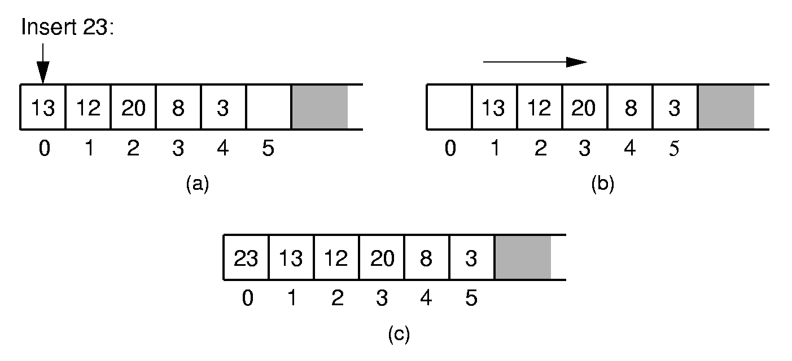
Array-Based List Class (5) - Insert
Questions:
How many moves are performed in the best, worst and average cases?
The order of movement?
Notes:
Push items up/down. Cost: Θ(n).

Slide 21
Array-Based List Class (6) - Insert
Better implementation?
// Insert at front of right partition
template <class E>
void AList<E>::insert(const E& item) {
Assert (listSize < maxSize,
“List capacity exceeded”);
for(int i=listSize; i>curr; i--)
// Shift Elems up to make room
listArray[i] = listArray[i-1]; listArray[curr] = item;
listSize++; // Increment list size
}
Why???
Θ(n)
Insert item
listArray
curr
listSize
maxsize

Slide 22
Array-Based List Class (7) - append
// Append Elem to end of the list
template <class E>
void AList<Elem>::append(const E& item) {
Assert (listSize < maxSize,
“List capacity exceeded”);
listArray[listSize++] = item;
}
append item
listArray
listSize
curr
maxsize

Slide 23
Array-Based List Class (8) - remove
// Remove and return the current element
template <class E>
Elem AList<E>::remove() {
Assert ((curr>=0) && (curr < listSize),
“No element”);
E it = listArray[curr]; // Copy Elem
for(int i=curr; i<listSize-1; i++)
// Shift them down
listArray[i] = listArray[i+1];
listSize--; // Decrement size
return it;
}
Θ(n)
remove
listArray
curr
listSize
maxsize

Slide 24
What to store
Data
Logical relationship between data
Array-based list
linked list
Question:
How to present the logical relationship between data?

Slide 25
1. lists
1.1 Definition of lists
1.2 ADT of lists
1.3 Basic Implementation of Lists
1.3.1 Array-based List
1.3.2 Linked List
1.3.3 Comparison
1.4 Free list
1.5 Double Linked List

Slide 26
List Node
Dynamic allocation of new list elements.
// Singly-linked list node
template <class E> class Link {
public:
E element; // Value for this node
Link *next; // Pointer to next node
Link(const E& elemval,
Link* nextval =NULL)
{ element = elemval; next = nextval; }
Link(Link* nextval =NULL)
{ next = nextval; }
};
element next

Slide 27
Linked List Class (1)
// Linked list implementation
template <class E>
class LList:public List<E> {
private:
Link<E>* head; //Point to list header
Link<E>* tail; //Pointer to last Elem Link<E>* curr;//access to current elem int cnt; //Size of list
what's for
what's for
tail
head
curr
Why is the position here?

Slide 28
Linked List Class (2)
void init() { //Initialization routine
curr = tail = head = new Link<E>;
cnt = 0;
}
The head node is a special node to
indicate the beginning of the list.
tail
head
Question:
What are the advantages of a singly linked list with the head node?
curr

Slide 29
Linked List Class (2)
void removeall() {
//Return link nodes to free store
while(head != NULL) {
curr = head;
head = head->next;
delete curr;
}
}
tail
Time efficiency?
head
NULL

Slide 30
Linked List Class (3)
public:
LList(int size=DefaultListSize)
{ init(); }
~LList() { removeall(); } // Destructor
void clear() { removeall(); init(); }
void print() const; //Print list contents

Slide 31
Linked List Class (4)
void moveToStart() { curr = head; }
void moveToEnd() { curr = tail; }
void next() {
if (curr != tail) curr = curr->next;
}
int Length() const { return cnt; }
const E& getValue() const {
Assert(curr->next != NULL, “No value”);
return curr->next->element;
}
Time efficiency?

Slide 32
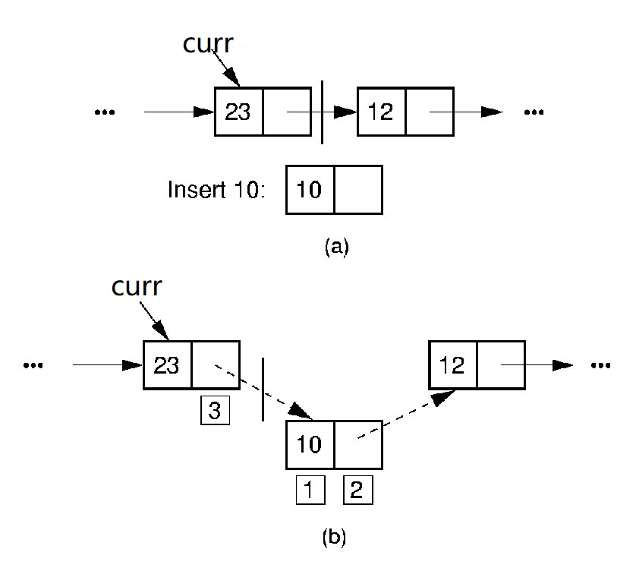
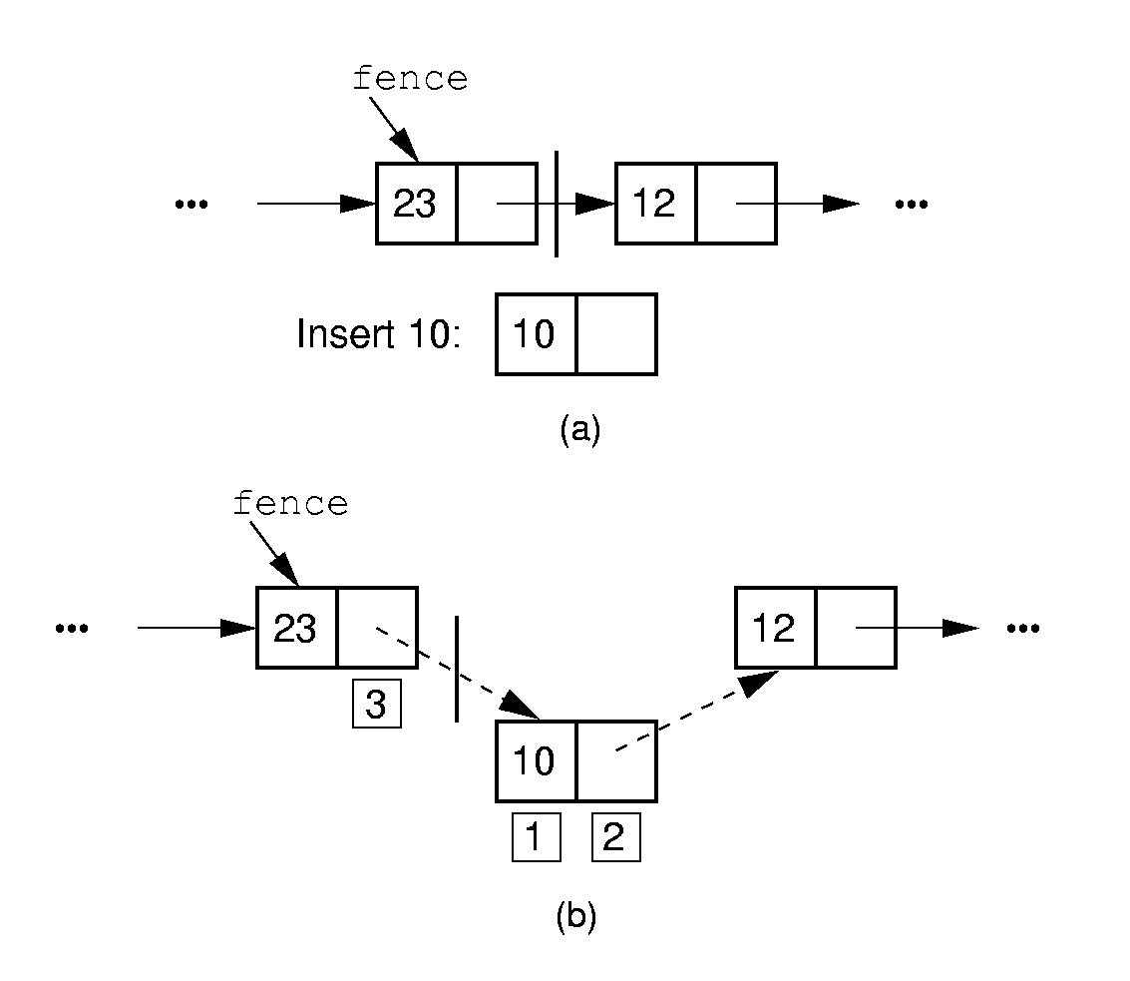
Linked List Class (4) - Insert

Slide 33
Linked List Class (5) Insert
// Insert item at current position
template <class E>
void LList<Elem>::insert(const E& item) {
curr->next =
new Link<E>(item, curr->next);
if (tail == curr) tail = curr->next; cnt++;
}
tail
head
curr
item

Slide 34
Linked List Class (5) Insert
//Insert item at current position
template <class Elem>
void LList<Elem>::insert(const E& item) {
curr->next =
new Link<E>(item, curr->next);
if (tail == curr) tail = curr->next; cnt++;
}
Θ(1)
tail
head
item
curr

Slide 35
Linked List Class (6) -Append
// Append Elem to end of the list
template <class E>
void LList<E>::append(const E& item) {
tail = tail->next =
new Link<E>(item, NULL);
cnt++;
}
tail
head
item
curr

Slide 36
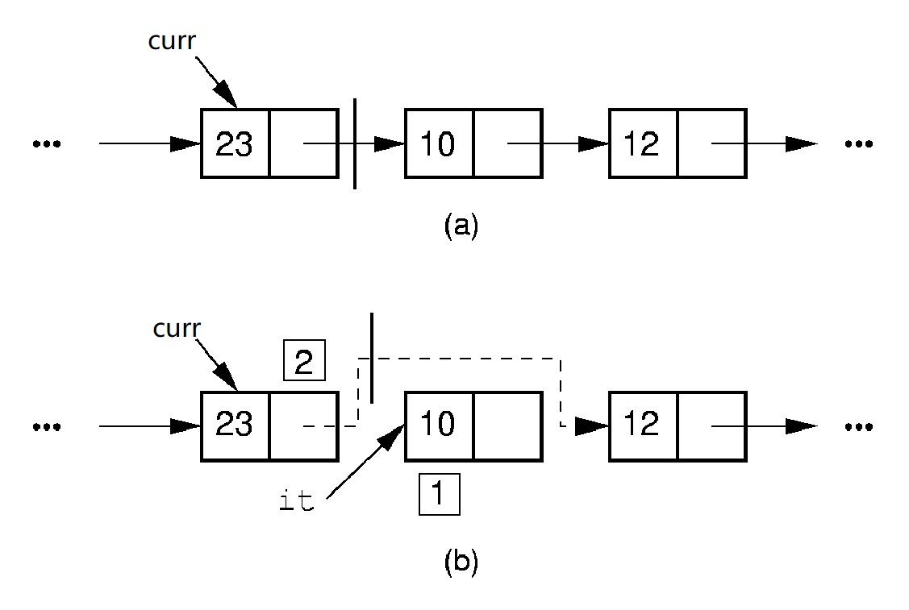
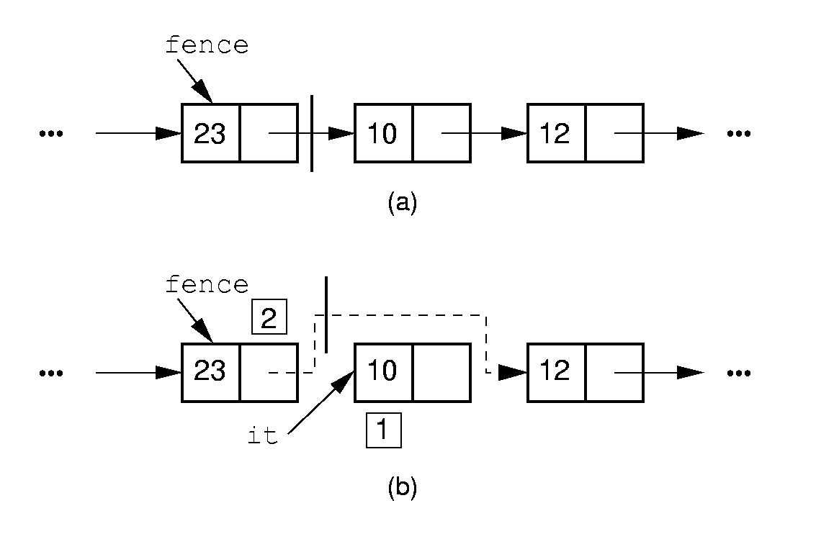
Linked List Class (6) -Remove

Slide 37
Linked List Class (7) -Remove
// Remove and return current element
template <class E>
Elem LList<Elem>::remove() {
Assert (curr->next != NULL,”No elemtent”);
E it = curr->next->element;
// Remember link node
Link<E>* ltemp = curr->next;
if(tail==curr->next) tail=curr;
curr->next = curr->next->next; // Remove
delete ltemp; // Reclaim space
cnt--;
return it;
}
tail
curr
head
ltemp

Slide 38
Linked List Class (7) -Remove
// Remove and return current element
template <class Elem>
Elem LList<E>::remove() {
Assert (curr->next != NULL,”No elemtent”);
E it = curr->next->element;
// Remember link node
Link<E>* ltemp = curr->next;
if(tail==curr->next) tail=curr;
curr->next = curr->next->next; // Remove
delete ltemp; // Reclaim space
cnt--;
return it;
}
Θ(1)
tail
curr
head
ltemp

Slide 39
Prev
// Move curr one step left;
// no change if already at front
template <class E>
void LList<E>::prev() {
if (curr == head) return; // No prev
Link<E>* temp = head;
while (temp->next!=curr)
temp=temp->next;
curr = temp;
}
Θ(n)
tail
temp
head
curr

Slide 40
movrToPos
// move down list to pos position
template <class E>
void LList<E>::moveToPos(int pos) {
Assert (((pos>=0)&&(pos<=cnt),
“Position out of range”);
curr = head;
for(int i=0; i<pos; i++)
curr =curr->next;
}
Θ(n)
tail
head
curr

Slide 41
currPos
// Return the position of the current element
int currPos() const {
Link<E>* temp = head;
int i;
for (i=0; curr != temp; i++)
temp = temp->next;
return i;
}
Θ(n)
tail
head
curr

Slide 42
1. lists
1.1 Definition of lists
1.2 ADT of lists
1.3 Basic Implementation of Lists
1.3.1 Array-based List
1.3.2 Linked List
1.3.3 Comparison
1.4 Free list
1.5 Double Linked List

Slide 43
Comparison of Implementations
Array-Based Lists:
Insertion and deletion are Θ(n).
Prev and direct access are Θ(1).
Array must be allocated in advance.
No overhead if all array positions are full.
Linked Lists:
Insertion and deletion are Θ(1).
Prev and direct access are Θ(n).
Space grows with number of elements.
Every element requires overhead.
Notes:
Applies to both average and worst cases.

Slide 44
Space Comparison
Array-Based Lists Linked Lists
DE vs. n(P + E)
E: Space for data value.
P: Space for pointer.
D: Maximum Number of elements in array.
n: current number of elements

Slide 45
1. lists
1.1 Definition of lists
1.2 ADT of lists
1.3 Basic Implementation of Lists
1.3.1 Array-based List
1.3.2 Linked List
1.3.3 Comparison
1.4 Free list
1.5 Double Linked List

Slide 46
Freelists (1)
System new and delete are slow.
Organize the freed nodes as a list call ‘freelist’
freelist
freelist
delete

Slide 47
Freelists (2)
System new and delete are slow.
Organize the freed nodes as a list call ‘freelist’
freelist
new

Slide 48
Freelists (3)
// Singly-linked list node with freelist
template <class E> class Link {
private:
static Link<E>* freelist; // Head
public:
E element; // Value for this node
Link* next; // Point to next node Link(const E& elemval,
Link* nextval =NULL)
{ element = elemval; next = nextval; }
Link(Link* nextval =NULL) {next=nextval;}
void* operator new(size_t); // Overload
void operator delete(void*); // Overload
};
element next
freelist

Slide 49
Freelists (4)
template <class E>
Link<E>* Link<E>::freelist = NULL;
template <class E> // Overload for new
void* Link<E>::operator new(size_t) {
if (freelist == NULL) return ::new Link;
Link<E>* temp = freelist; // Reuse
freelist = freelist->next;
return temp; // Return the link
}
temp
freelist

Slide 50
Freelists (5)
template <class E> // Overload delete
void Link<E>::operator delete(void* ptr){
((Link<E>*)ptr)->next = freelist;
freelist = (Link<E>*)ptr;
}
ptr
freelist

Slide 51
1. lists
1.1 Definition of lists
1.2 ADT of lists
1.3 Basic Implementation of Lists
1.3.1 Array-based List
1.3.2 Linked List
1.3.3 Comparison
1.4 Free list
1.5 Double Linked List

Slide 52
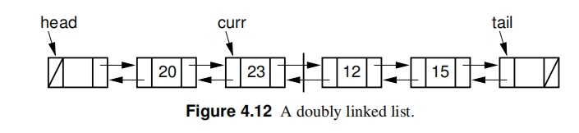
Doubly Linked Lists (1)
Simplify the prev() operation: Add a pointer pointing to
the previous node.

Slide 53
Doubly Linked Lists (2)
// Doubly linked list
template <typename E> class Link {
public:
E element;
Link* next;
Link* prev;
Link(const E& it, Link* prevp, Link* nextp) {element = it;prev = prevp;next = nextp;
}
Link(Link* prevp =NULL, Link* nextp =NULL) {prev = prevp;next = nextp;}
prev element next

Slide 54
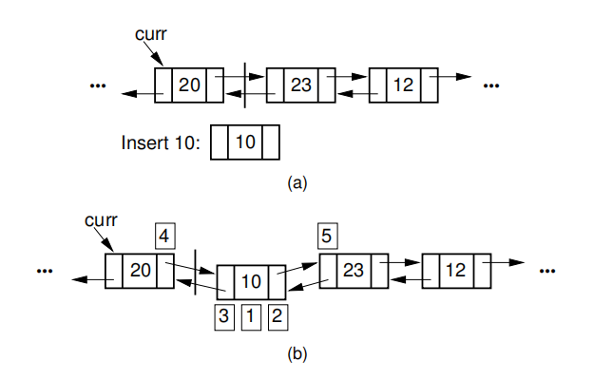
Doubly Linked List - Insert (3)

Slide 55
Doubly Linked List – Insert (4)
// Insert "it" at current position
void insert(const E& it) {
curr->next = curr->next->prev =
new Link<E>(it, curr, curr->next);
cnt++;
}
tail
curr

Slide 56
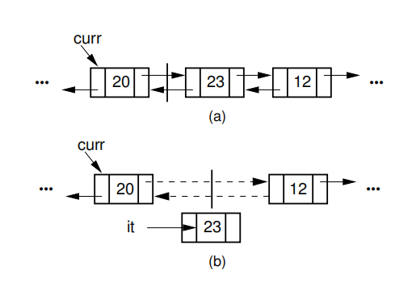
Doubly Linked List – Remove (5)

Slide 57
Doubly Linked List – Remove (6)
// Remove and return current element
E remove() {
if (curr->next == NULL) // Nothing to remove
return NULL;
E it = curr->next->element; //Remember value
Link<E>* ltemp = curr->next; // Remember
link node
if (ltemp->next != NULL)
ltemp->next->prev = curr;
else tail = curr;
curr->next = ltemp->next; // Remove
from list
delete ltemp; // Reclaim space
cnt--; // Decrement cnt
return it;
}
tail
curr
ltemp

Slide 58
Definition of Stacks
Stack: A restricted form of list: Insert and
remove only at front of list.
LIFO property: Last In, First Out.
Notation:
Insert: PUSH
Remove: POP
The accessible element is called TOP.
push
pop
TOP

Slide 59
Stack ADT
// Stack abtract class
template <class Elem> class Stack {
private:
void operator = (const Stack&){}
Stack(const Stack&) {}
public:
// Reinitialize the stack
virtual void clear() = 0;
// Push an element onto the top of the stack.
virtual void push(const Elem&) = 0;
// Remove the element at the top of the stack.
virtual Elem pop() = 0;
// Get a copy of the top element in the stack
virtual const Elem& topValue() const = 0;
// Return the number of elements in the stack.
virtual int length() const = 0;
};

Slide 60
2. Stacks
2.1 Definition of Stacks
2.2 ADT of Stacks
2.3 Basic Implementation of Stacks
2.3.1 Array-based Stack
2.3.2 Linked Stack
2.4 Application of stacks

Slide 61
Array-Based Stack (1)
// Array-based stack implementation
template <class Elem> class AStack: public Stack<Elem>
{
private:
int maxsize; // Maximum size of stack
int top;//The position to insert the new element
Elem *listArray; //Array holding stack elements
push
listArray
pop
top
size

Slide 62
Array-Based Stack (2)
public:
AStack(int sz =DefaultListSize)
{ maxsize = sz; top = 0;
listArray = new Elem[sz]; }
~AStack() { delete [] listArray;
void clear() { top = 0; }
Stack is empty
listArray
top
size
After push one
element
listArray
top
size

Slide 63
Array-Based Stack (3)
void push(const Elem& item) {
Assert (top != size, “Stack is full”);
listArray[top++] = item;
}
item
listArray
top
size

Slide 64
Array-Based Stack (4)
// Pop top element
Elem pop() {
Assert (top != 0,”Stack is empty”);
return listArray[--top]; }
}
it
listArray
top
size

Slide 65
Array-Based Stack (5)
// Return top element
const Elem& topValue() const {
Assert (top != 0, “stack if empty”);
return listArray[top-1];
}
int length() const { return top; }
};
it
listArray
top
size

Slide 66
2. Stacks
2.1 Definition of Stacks
2.2 ADT of Stacks
2.3 Basic Implementation of Stacks
2.3.1 Array-based Stack
2.3.2 Linked Stack
2.4 Application of stacks

Slide 67
Linked Stack (1)
// Linked stack implementation
template <class Elem> class LStack: public tack<Elem>
{
private:
Link<Elem>* top; // Pointer to first elem
int size; // Count number of elems
top

Slide 68
Linked Stack (2)
public:
LStack(int sz =DefaultListSize)
{ top = NULL; size = 0;}
top
NULL
size = 0
Stack is empty
top
size = 1
After push 1 element
top
size = 2
After push 2 elements

Slide 69
Linked Stack (3)
~LStack() {clear();}
void clear() {
while(top != NULL){
LINK<Elem>* temp = top;
top = top->next;
delete temp;
}
size = 0;
}
top
NULL
temp

Slide 70
Linked Stack (4)
void push(const Elem& it) {
top = new Link<Elem> (it, top);
size ++;
}
it
top
with head node or not? why?

Slide 71
Linked Stack (5)
// Pop top element
Elem pop() {
Assert(top != NULL, “Stack if empty”);
Elem it = top->element;
Link<Elem>* ltemp = top->next;
delete top;
top = ltemp;
size--;
return it;
}
top
ltemp

Slide 72
Linked Stack (6)
// Return top element
const Elem& topValue() const {
Assert(top!= 0, “stack is empty”);
return top->element;
}
int length() const {return size;}
};
top

Slide 73
2. Stacks
2.1 Definition of Stacks
2.2 ADT of Stacks
2.3 Basic Implementation of Stacks
2.3.1 Array-based Stack
2.3.2 Linked Stack
2.4 Application of stacks

Slide 74
Application of stack(1) – Subroutine Call
Subroutine call.
Before calling a subroutine, the context (return address, parameters, local variables) is stored into the a stack.
4000
int a = 0;
int b =1;
Dosomething (a,b);
a = a + b;
4001
4003,0,1
4002
4003
Dosomthing(int x, int y)
{
… … }
context
context

Slide 75
Application of stack(1) – Subroutine Call (cont.)
Implementation of Recursion
// The recursion version to compute n!
long fact(int n)
{
if (n <= 1) return 1; // Base case: return base solution
return n * fact(n-1); // Recursive call for n > 1
}
300
301
fact(4)
fact(3)
fact(2)
fact(1)
fact(2)
fact(3)
fact(4)
return 1
return 2
301,4
301,3
301,2
return 6
return 24

Slide 76
Replacing the Recursion with a user defined stack
// The non-recursion version with a stack to compute n!
long fact(int n, Stack<int>& S) { // Compute n!
while (n > 1) S.push(n--); // Load up the stack
long result = 1; // Holds final result
int val; // Holds current value
while(S.pop(val)) result = result * val; // Compute
return result;
}
result = 1
result = 2
fact(4)
result = 6
4
3
2
result = 24

Slide 77
Application of stack(2) – Verify the Balance of Parentheses
Eg. The string “((())())” contains balanced parentheses. The string“(()” are not balanced.
Write a program with a stack to check if a string contains properly nested and balanced parentheses. (p137. 4.20)
(
(
(
(
(
(
(
)
)
(
)
)
(
(
(
(
)

Slide 78
3. Queues
3.1 Definition of Queues
3.2 ADT of Queues
3.3 Basic Implementation of Queues
3.3.1 Array-based Queues
3.3.2 Linked Queues
3.4 Application of Queues

Slide 79
Definition of Queues
Queue: A restricted form of list - Insert at one end, remove from the other.
FIFO property: First in, First Out
Notation:
Insert: enqueue
Delete: dequeue
First element: front
Last element: rear
enqueue
dequeue
front
rear

Slide 80
ADT of Queues
template <class Elem> class Queue {
private:
void operator = (const Queue&) { }
Queue(const Queue&) { }
public:
Queue() { }
virtual ~Queue() { }
virtual void clear() = 0;
virtual void enqueue(const Elem&) = 0;
virtual Elem dequeue( ) = 0;
virtual const Elem& frontValue() const = 0;
virtual int length() const = 0;
};

Slide 81
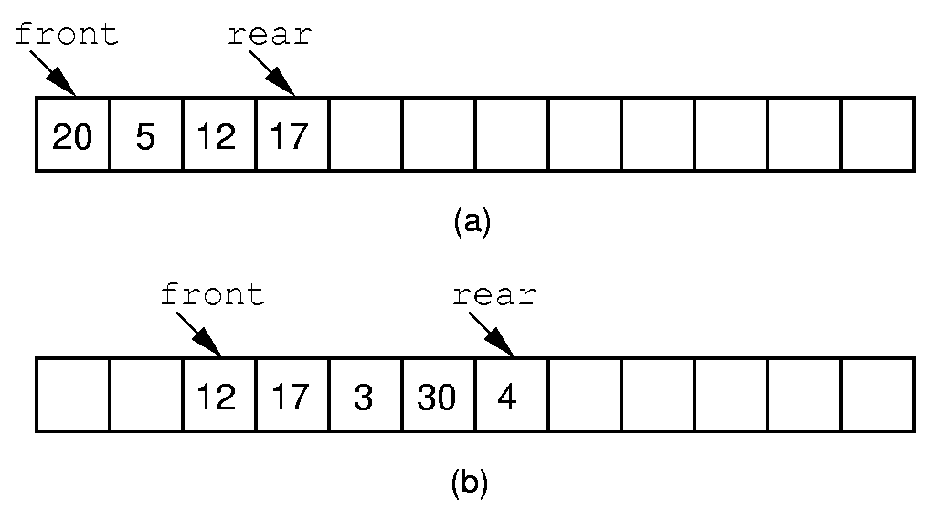
Array-based Queue Implementation (1)
Length of the queue
= rear – front + 1
front
rear
10
12
42
(c)
How to insert one more element?
Notes:
If we stick to the requirement that the queue elements be at the beginning n elements of the array, then either enqueue or dequeue must be θ(n).
Better is to let the elements “drift” within the array.
Unfortunately, as items are added and removed, the queue “drifts” toward the end. Eventually, there will be no space to the right of the queue, even though there is space in the array.

Slide 82
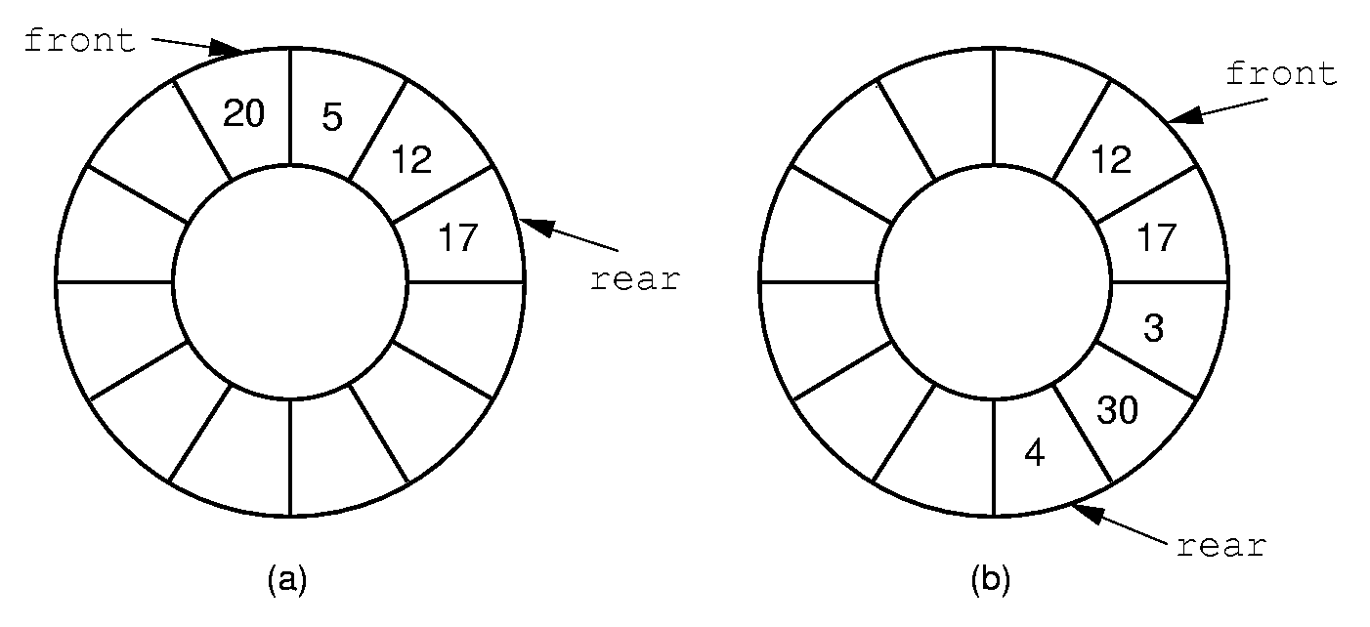
Array-based Queue Implementation (2)
Circular queue
Notes:
By using the mod function, we can easily achieve the effect of a “circular” queue.
This leaves one more issue. Where do the front and rear pointers go (point to the item? Or to the space before/after the item)? And, how do we distinguish a full from an empty queue?
Given a fixed position for the front element (and its pointer), there are n-1 possible states for the queue (0 through n elements in the queue for an array of size n), but only n possible positions for rear. To solve this dilemma, we must either leave an empty slot in the queue, or use and external variable to determine if the queue is empty or not.

Slide 83
Array-based Circular Queue
5
Array base
base
4
0
0
J6
1
J7
rear=1
2
3
1
3
J3
front=3
front
4
J4
2
5
J5
rear
For the No. i elements in the circular queue,
the position of the element next to it is:
(i+1)% size
The length of the queue is:
Length = (rear - front + 1) ?
Length = ((rear+size) - front + 1) % size

Slide 84
The state of a circular queue
rear
front
rear
rear
front
5
4
5
0
4
0
4
5
0
3
1
3
2
1
2
3
2
1
front
rear
5
front
4
0
3
2
1
5
4
0
front
3
2
1
rear
full
front = = (rear+1)%size
empty
How to distinguish?

Slide 85
Distinguish full and empty
4
5
0
4
5
0
3
1
3
1
2
2
front
front
rear
rear
(a) Empty
(b) Full
Only store n – 1 elements in a Circular queue with the length n.
Empty： front = = (rear+1)%size
Full： front = = (rear+2)%size

Slide 86
Implementation of the Array-Based Circular Queue(1)
template <class Elem> class AQueue: public Queue<Elem>
{
private:
int maxsize; // Maximum size of queue
int front; // Index of front element
int rear; // Index of rear element
Elem *listArray; // Array holding queue elements
maxsize = 6
5
listArray
listArray
4
0
0
J6
1
J7
rear=1
2
3
1
3
J3
front=3
front
4
J4
2
5
J5
rear

Slide 87
Implementation of the Array-Based Circular Queue(1)
template <class Elem> class AQueue: public Queue<Elem>
{public:
AQueue(int size=defaultSize) {
maxSize = size+1;
rear=0; front=1;
listArray = new Elem[maxSize];
}
~AQueue () {delete [] listArray;
maxsize = 6
5
listArray
listArray
4
0
0
J6
1
J7
rear=1
2
3
1
3
J3
front=3
front
4
J4
2
5
J5
rear

Slide 88
Implementation of the Array-Based Circular Queue(2)
void clear() { rear=0; front=1; }
void enqueue(const Elem& it) {
Assert((rear+2) % size) != front, “Queue if full”);
rear = (rear+1) % size; // Circular increment
listArray[rear] = it;
}
rear
4
5
0
5
5
3
1
4
0
4
0
2
3
2
1
3
2
1
front
front
rear
front
rear
Empty
Full
enqueue

Slide 89
Implementation of the Array-Based Circular Queue(3)
front = = (rear+1)%size
Elem dequeue(Elem& it) {
Assert (length() != 0, “Queue is empty);
it = listArray[front];
front = (front+1) % maxsize; // Circular increment
return it;
}
rear
4
5
0
5
5
3
1
4
0
4
0
2
3
2
1
3
2
1
front
front
front
it = J₃
rear
rear
Empty
Full
dequeue

Slide 90
Implementation of the Array-Based Circular Queue(4)
const Elem& frontValue(Elem& it) const {
Assert (length() != 0,”Queue if empty”);
return listArray[front];
}
virtual int length() const
{ return ((rear+size) - front + 1) % maxsize; }
};
rear
4
5
0
3
2
1
front
it = J₃

Slide 91
3. Queues
3.1 Definition of Queues
3.2 ADT of Queues
3.3 Basic Implementation of Queues
3.3.1 Array-based Queues
3.3.2 Linked Queues
3.4 Application of Queues

Slide 92
Linked Queues
tail
head
tail
head
dequeue
tail
head
enqueue

Slide 93
3. Queues
3.1 Definition of Queues
3.2 ADT of Queues
3.3 Basic Implementation of Queues
3.3.1 Array-based Queues
3.3.2 Linked Queues
3.4 Application of Queues

Slide 94
Application of Queue(1)- Buffer
Low speed devices
Queues for data buffer
High speed processor

Slide 95
Application of Queue(2)-Message Queue
Asynchronous collaboration between different
components.
Eg. Message Queue in Windows.
Message consumer
Message producer
dequeue
enqueue

